Slide 1
Design Review Process
October 1, 2021
Enterprise Architecture

Slide 2
Version Control
Version | Date | Author | Description
1.3 | 10/1/2021 | Donna Sison

Slide 3
Contents
Design Review Overview
Design Review Process

Slide 4
Design Review – Overview
What are they and why do we need them?
Design Reviews-WHAT
Design reviews are collaborative sessions where technical requirements or designs created by delivery teams are reviewed by architects and other delivery teams. The sessions confirm that technical requirements or designs created by the application, infrastructure, security, data & analytics and BI/reporting delivery teams match the solution architecture. Design Reviews are: A required step in the SDLC process where sign off is required Scheduled and hosted by delivery teams Presented by Technical Leads (or their representatives) Attended by Solution and/or Domain architect(s) and Delivery Partners
Design Reviews-WHY
Design reviews ensure cross functional, continuous engagement as well as traceability of technical requirements and design to architecture. They support adherence to timeline and avoidance of production issues and technical debt. Delivery teams have experienced negatively impactful issues later in the project lifecycle without them. Design Reviews also: Provide a clear roadmap for build teams Enforce accountability & consistency thru the technical requirements or design artifact and sign off process Allow partner provider teams to be engaged early enough to properly socialize their technical requirements or design Maintain and establish technology governance required by TMO, release management, internal & external audits

Slide 5
Design Review – Overview
When and how do they happen?
Design Reviews-WHEN
Design reviews occur after solutions have been approved by the ARB and are in the design phase of the SDLC or when change requests and emergency deployments are in the design phase.
Design Reviews-HOW
Design Review Engagement Model
1. Develop Conceptual Architecture
2. Develop L1 Architecture
3. Develop L2 Architecture
E
Enterprise Architecture
I
IT Infrastructure
S
IT Security
2. Present L1 Architecture to ARB
3. Socialize L2 Architecture
A
Application Team
D
Data & Analytics
2. Socialize L1 Architecture
4. Develop Technical Design
5. Review Technical Design

Slide 6
Design Review Process What is the process?
Solution Architect
Start
Socialize ARB-approved L1 Solution Architecture
Socialize L2 Solution Architecture
Review Technical Design(s)
  Schedule Technical Design Review Session(s)
  Present Technical Design(s)
Design
Matches
Architecture?
Architecture
Changes
Required?
Update
E
KDD - Key Design Decision
Solution Architecture
N
Y
4
2
Y
N
Technical Debt
Record Deviations in Design Review Findings
Present to Chief Architect
Disclose to ARB
1
Delivery Team
IT infrastructure tech leads
security tech leads
application tech leads
data & analytics tech leads
Initiate Development
Resolve before Go-Live?
`
N
Develop Technical Design(s)
End
Y
I
S
A
D
Update Design
3
Chief Architect / ARB
Y
E
Review Updates
Present
to
ARB?
Solution
Approved?
N
Exception Mgmt. Process
N
End
Y
1
2
3
4
Deliverables
Technical Design Document (s)
Minutes of Design Review
Updated Design
Updated KDD, Solution Architecture, Tech Debt
Technical Design Document

Slide 7
Design Review Process
Who are involved and what are the templates?
Design Reviews-Requirements/Templates
Technical leads (or their assigned representatives) create technical requirements or design documents using the Design Templates below and present them during the review. Attendees review them and give feedback.
Team
Technical Leads
(create & present)
Team Members
(attend & review)
Design Template
Application
Marketing & Distribution – Edward Ruiz
Client Solutions – Edward Ruiz
Corporate Systems – Praful Mohite
ITSO
Vendor partners
Others
Application Design Review Template
BPD_Handoff_Checklist v1.0
FD_Handoff_RICEFW_ID_Desc_Checklist v1.0
IT Infrastructure
Steve Eddy
Network / Cloud - Jacob Zwennes
Infrastructure - Matt Agostinelli
BHF TDD Template v3.3.docx
Infra Intake and Engineering Process
IT Security
Steven Bell
Tara Hunter
Jason South, Keenan Murphy, Shawn Robinson, Joe Rodden, Masika Lawrence, Riley Watt, Gray Hinnant
Assurance Security Documents
Data & Analytics
Ray Lavoie
Rob Stein
Frank Foley
Glen Watson
Technical Design Solution & Application, Feature, EPIC Levels
Development Application, Feature, EPIC Level
BI CoE Business Report Requirements
Enterprise Architecture
Solution Architect
Domain Architect

Slide 8
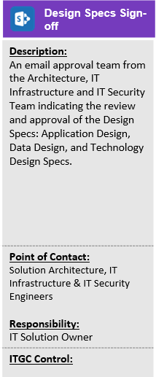
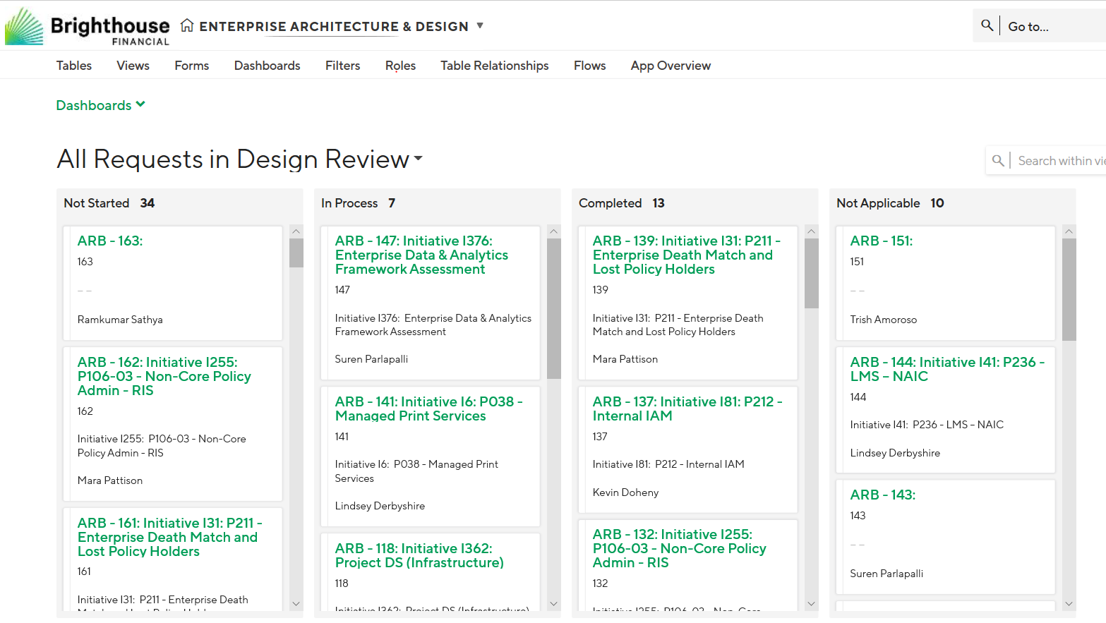
Design Review Process
Who signs off and how are sign offs tracked?
Design Reviews-SIGN OFFS
Architects and partner providers provide verbal or email sign off on the design review meetings. Architects record design review status in the EA TrackVia site. TMO tracks SDLC design phase completion via toll gates.

Slide 9
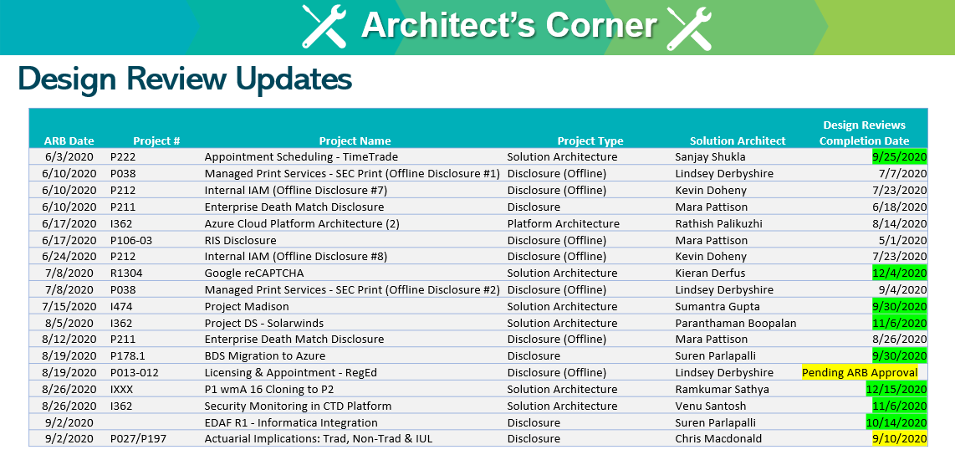
Design Review Process
What reporting is provided?
Design Reviews-REPORTING
Design review metrics are shared by EA on the TMO meetings

Slide 10


